Slide 1

Application Deployment
ON hEROKU

Slide 2
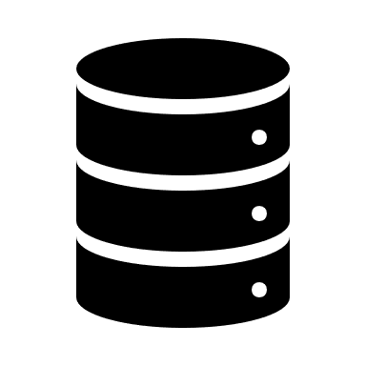




Local Application
Your Local Machine
DB
Flask App
Local User DOM
Web files
(HTML/CSS/JS)

Slide 3
Deployed to Github Pages
Your Local Machine
Github Repo
Flask App
DB
Web files
(HTML/CSS/JS)
User DOM

Slide 4

Deployed to Heroku
Heroku Platform
Heroku App
DB
User DOM
Github Repo
Web files
(HTML/CSS/JS)
Flask App
Config Files

Slide 5
Deployment Steps
Create application and deploy to GitHub repo
Add Heroku configuration files
Create the Heroku application
Prepare the Heroku database
Populate Heroku database

Slide 6
Create the application
There are many ways to organize and name your application files, however in order to use the example code with out modifications:
Name your Flask application file: app.py
Store your app file in the root directory
If your app utilizes a database, use a PostgreSQL database

Slide 7
Add configuration files
Heroku needs a few additional files to tell it how to run the application. Add these to the root directory:
initdb.py – initializes database
requirements.txt – list of python libraries Heroku needs to install
run.sh – shell file
Procfile – used b Heroku to run the app

